Slide 1
URBAN ADAPTATION IN OUR CITY Using the ND-GAIN Urban Adaptation Assessment
Presented by [Name]
[Date]
Notes:
Note to Presenter: Replace “Our City” here on this slide and elsewhere in the presentation with your city’s name if desired.

Slide 2
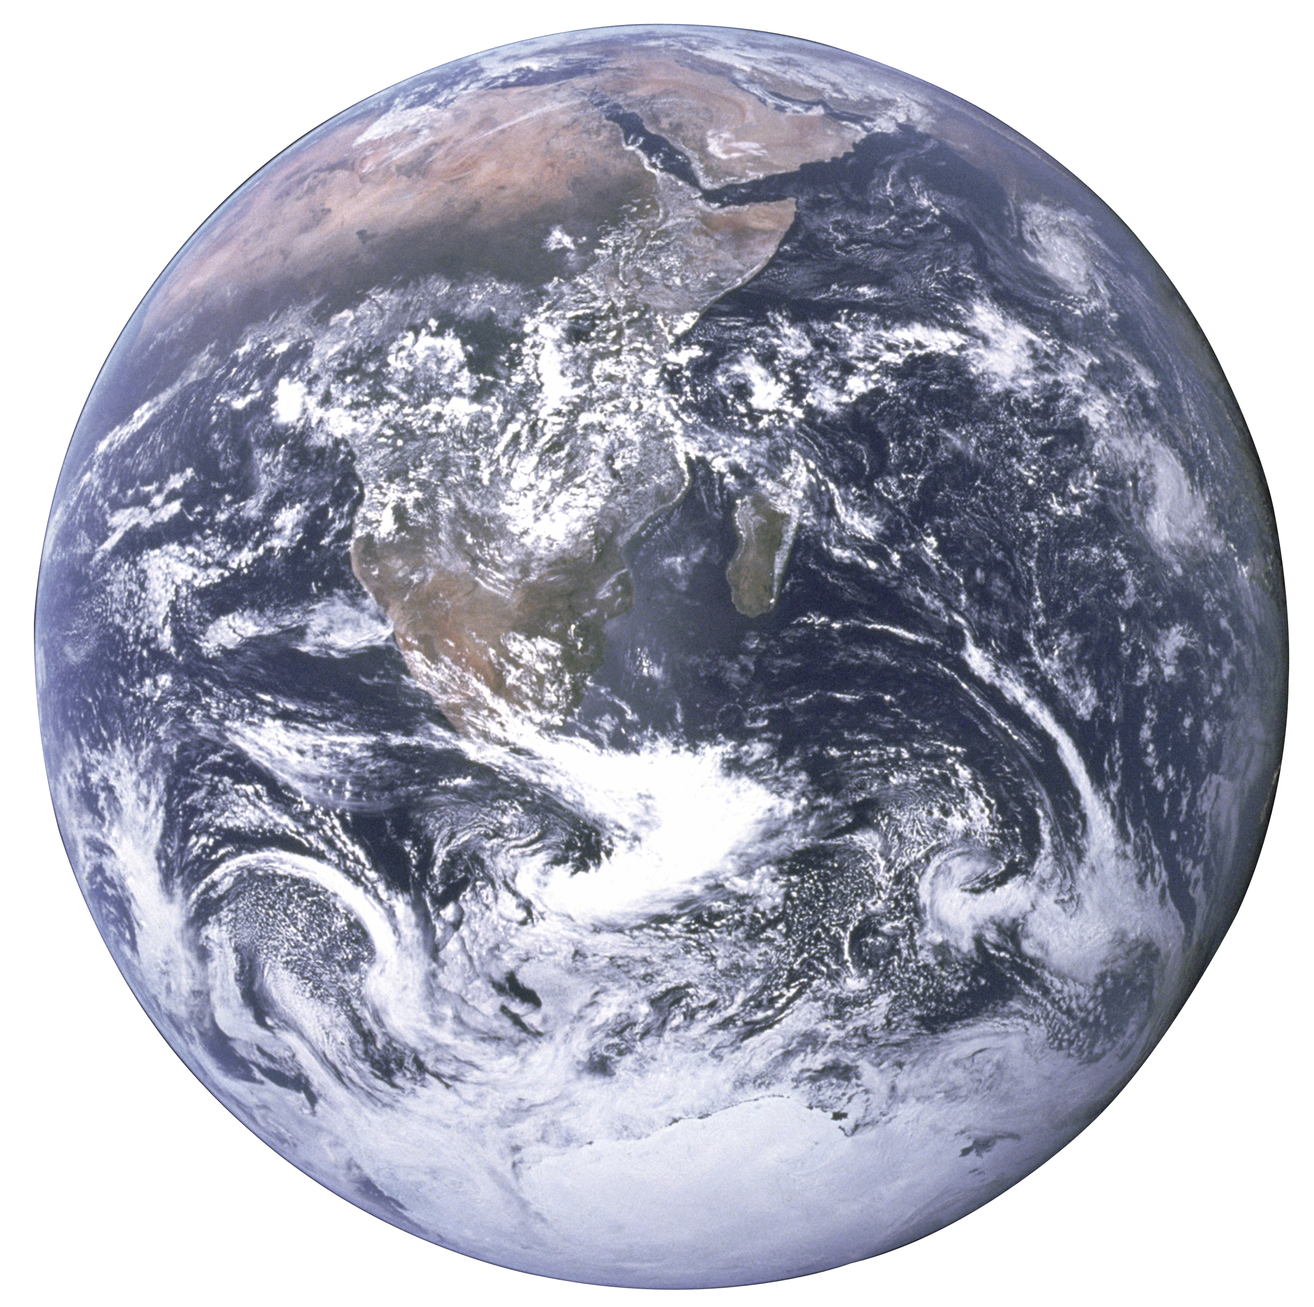
ADAPTATION
An adjustment to the changing climate that minimizes negative effects on human lives and livelihoods
Includes changing policy, operations and physical assets to modify supply chains, capital projects, community engagements and regulations
Notes:
Note to presenter: This slide presents an opportunity to review with your audience what adaptation means and how it is employed in the Urban Adaptation Assessment tool.

Slide 3
RISK AND READINESS
Risk: A city’s vulnerability to climate change. Risk incorporates:
Exposure
Sensitivity
Adaptive Capacity
Notes:
Note to presenter: This slide introduces the topics risk and readiness in the context of climate change. This will provide a basis for understanding the data from the Urban Adaptation Assessment tool.
Risk refers to a city’s vulnerability to climate change. Risk incorporates a city’s exposure, sensitivity and adaptive capacity:
Exposure relates to physical exposure, which means the number of individuals and critical infrastructure exposed to climate hazard event. Exposure has a geographic and temporal character.
For extreme cold, heat, flooding and sea-level rise, sensitivity refers to the degree to which population of the city are affected by climate hazards.
Adaptive capacity refers to the city’s ability to respond to the consequences of climate hazards.
By way of example, drought sensitivity refers to the degree to which economic sectors rely on water-intensive industries (agriculture, water transportation, mining, utilities) and adaptive capacity reflect ability of the city to manage drought through the management plans, or early warning systems.

Slide 4
RISK AND READINESS
Readiness: The capacity of an urban society has to mobilize adaptation investments from private sectors, and to target investments more effectively.
Economic Readiness
Governance Readiness
Social Readiness
Notes:
Note to presenter: This slide introduces the topic of readiness as it pertains to climate change.
Readiness refers to the capacity of an urban society has to mobilize adaptation investments from private sectors, and to target investments more effectively. Readiness is a function of economic, governance, and social readiness:
Economic Readiness: The economic condition to support adaptation and to attract adaptation investment.
Governance Readiness: The governance support that enables effective use of adaptation investment.
Social Readiness: The social capacity that facilitates the uptake of the benefits brought about through adaptation investment.

Slide 5
ND-GAIN URBAN ADAPTATION ASSESSMENT
Online, data-rich tool for visually connecting city’s vulnerabilities to climate disasters, adaptive capacities, and how these are distributed within a city
Led by the Notre Dame Global Adaptation Initiative (ND-GAIN), funded by the Kresge Foundation
Data from over 270 U.S cities in all 50 states and Puerto Rico
Notes:
Note to presenter: This slide provides a brief overview of the ND-GAIN Urban Adaptation Assessment Tool for audience members that may not be familiar with it.

Slide 6
OUR CITY’S UAA PROFILE
 | FLOOD | HEAT | COLD | SEA LEVEL RISE | DROUGHT
Historical average cost (2011-2015)
Probability of hazard event in 2040
Projected cost
Notes:
Note to presenter: This slide presents an opportunity for a brief overview of your city’s profile for all 5 hazards. Remove hazard columns if desired.

Slide 7
OUR CITY’S FLOOD RISK
Historical average cost (2011-2015) | Probability of flood event in 2040 | Projected cost of flood event
[XX] | [XX] | [XX]
Exposure score | Adaptive capacity | Sensitivity score
[XX] | [XX] | [XX]
% of buildings in high risk flood zone % of cars in high risk flood zone % of population living in high risk flood zone | No. of acute care hospital beds available per 1000 residents % of population with health insurance Water quality enforcement | % of area that is impervious surface % of buildings built before 1999 % of households without access to a vehicle % of population spending over 50 percent of income on rent % of population that is 65 years or older living alone % of population that is under 5 years old % of total housing units that are mobile homes
Notes:
Note to Presenter: Include data from the “Potential Future Cost” window in your Flood report table above as well as your city’s Exposure, Adaptive Capacity and Sensitivity scores (replace [XX]s). Bulleted lists include factors that make up Exposure, Adaptive Capacity and Sensitivity scores. Your city specific numbers can be added by downloading your data here: https://gain-uaa.nd.edu/static/UAA%20Data.zip
Exposure score (lower is better): [XX]
Adaptive Capacity score (higher is better): [XX]
Sensitivity score (lower is better): [XX]

Slide 8
OUR CITY’S FLOOD READINESS
Historical average cost (2011-2015) | Probability of flood event in 2040 | Projected cost of flood event
[XX] | [XX] | [XX]
Social score | Economic score | Governmental score
[XX] | [XX] | [XX]
Civic engagement General innovation capabilities | Bond worthiness City debt per resident Tax incentives for renewable energy | Estimated % adults who think global warming is already harming people in the US or will within 10 years % population with a 12th grade education or higher Total no. of federal public corruption convictions by district
Notes:
Note to Presenter: Include data from the “Potential Future Cost” window in your Flood report table above as well as your city’s Social, Economic and Governmental scores (replace [XX]s). Bulleted lists include factors that make up Social, Economic and Governmental scores. Your city specific numbers can be added by downloading your data here: https://gain-uaa.nd.edu/static/UAA%20Data.zip
Social Readiness score (higher is better): [XX]
Economic Readiness score (higher is better): [XX]
Governmental Readiness score (higher is better): [XX]

Slide 9
FLOODING IN OUR NEIGHBORHOODS
[Built Environment Indicator] x [Social Vulnerability Factor]
Notes:
Note to Presenter: Type in the Built Environment and Social Vulnerabilities that you selected in the text box above. Include a screenshot of the sub-city map in the image box above. For support exploring the sub-city map, visit the Help Center to view short video tutorials at https://gain.nd.edu/our-work/urban-adaptation/help-center/

Slide 10
RISING TO THE CHALLENGE OF FLOOD
Actions our city can take to…
Reduce risk:
Increase readiness:
Notes:
Note to Presenter: Include actions you have determined to reduce risk and/or increase readiness in your city. Consider reviewing the UAA Guide to Reflection available at https://gain.nd.edu/our-work/urban-adaptation/help-center/

Slide 11
OUR CITY’S HEAT RISK
Historical average cost (2011-2015) | Probability of heat event in 2040
[XX] | [XX]
Exposure score | Adaptive capacity | Sensitivity score
[XX] | [XX] | [XX]
Population density | No. of acute care hospital beds available per 1000 residents % of land covered by tree canopy % of population with health insurance | % of buildings built before 1979 % of employed population that works outdoors % of households receiving public assistance % of population spending over 50% income on rent % of population that is 65 years or older living alone % of population that is under 5 years old % of population with a disability
Notes:
Note to Presenter: Include data from the “Potential Future Cost” window in your Heat report table above as well as your city’s Exposure, Adaptive Capacity and Sensitivity scores (replace [XX]s). Bulleted lists include factors that make up Exposure, Adaptive Capacity and Sensitivity scores. Your city specific numbers can be added by downloading your data here: https://gain-uaa.nd.edu/static/UAA%20Data.zip
Exposure score (lower is better): [XX]
Adaptive Capacity score (higher is better): [XX]
Sensitivity score (lower is better): [XX]

Slide 12
OUR CITY’S HEAT READINESS
Historical average cost (2011-2015) | Probability of heat event in 2040
[XX] | [XX]
Social score | Economic score | Governmental score
[XX] | [XX] | [XX]
Civic engagement General innovation capabilities | Bond worthiness City debt per resident Tax incentives for renewable energy | Estimated % adults who think global warming is already harming people in the US or will within 10 years % population with a 12th grade education or higher Total no. of federal public corruption convictions by district
Notes:
Note to Presenter: Include data from the “Potential Future Cost” window in your Heat report table above as well as your city’s Social, Economic and Governmental scores (replace [XX]s). Bulleted lists include factors that make up Social, Economic and Governmental scores. Your city specific numbers can be added by downloading your data here: https://gain-uaa.nd.edu/static/UAA%20Data.zip
Social Readiness score (higher is better): [XX]
Economic Readiness score (higher is better): [XX]
Governmental Readiness score (higher is better): [XX]

Slide 13
HEAT IN OUR NEIGHBORHOODS
[Built Environment Indicator] x [Social Vulnerability Factor]
Notes:
Note to Presenter: Type in the Built Environment and Social Vulnerabilities that you selected in the text box above. Include a screenshot of the sub-city map in the image box above. For support exploring the sub-city map, visit the Help Center to view short video tutorials at https://gain.nd.edu/our-work/urban-adaptation/help-center/

Slide 14
RISING TO THE CHALLENGE OF HEAT
Actions our city can take to…
Reduce risk:
Increase readiness:
Notes:
Note to Presenter: Include actions you have determined to reduce risk and/or increase readiness in your city. Consider reviewing the UAA Guide to Reflection available at https://gain.nd.edu/our-work/urban-adaptation/help-center/

Slide 15
OUR CITY’S COLD RISK
Historical average cost (2011-2015) | Probability of cold event in 2040
[XX] | [XX]
Exposure score | Adaptive capacity | Sensitivity score
[XX] | [XX] | [XX]
Population density | No. of acute care hospital beds available per 1000 residents % of households with heating fuel %of population with health insurance | % of buildings built before 1979 % of employed population that works outdoors % of households receiving public assistance % of population spending over 50% income on rent % of population that have a disability % of population that is 65 years or older living alone % of population that is under 5 years old
Notes:
Note to Presenter: Include data from the “Potential Future Cost” window in your Cold report table above as well as your city’s Exposure, Adaptive Capacity and Sensitivity scores (replace [XX]s). Bulleted lists include factors that make up Exposure, Adaptive Capacity and Sensitivity scores. Your city specific numbers can be added by downloading your data here: https://gain-uaa.nd.edu/static/UAA%20Data.zip
Exposure score (lower is better): [XX]
Adaptive Capacity score (higher is better): [XX]
Sensitivity score (lower is better): [XX]

Slide 16
OUR CITY’S COLD READINESS
Historical average cost (2011-2015) | Probability of cold event in 2040
[XX] | [XX]
Social score | Economic score | Governmental score
[XX] | [XX] | [XX]
Civic engagement General innovation capabilities | Bond worthiness City debt per resident Tax incentives for renewable energy | Estimated % adults who think global warming is already harming people in the US or will within 10 years % population with a 12th grade education or higher Total no. of federal public corruption convictions by district
Notes:
Note to Presenter: Include data from the “Potential Future Cost” window in your Cold report table above as well as your city’s Social, Economic and Governmental scores (replace [XX]s). Bulleted lists include factors that make up Social, Economic and Governmental scores. Your city specific numbers can be added by downloading your data here: https://gain-uaa.nd.edu/static/UAA%20Data.zip
Social Readiness score (higher is better): [XX]
Economic Readiness score (higher is better): [XX]
Governmental Readiness score (higher is better): [XX]

Slide 17
COLD IN OUR NEIGHBORHOODS
[Built Environment Indicator] x [Social Vulnerability Factor]
Notes:
Note to Presenter: Type in the Built Environment and Social Vulnerabilities that you selected in the text box above. Include a screenshot of the sub-city map in the image box above. For support exploring the sub-city map, visit the Help Center to view short video tutorials at https://gain.nd.edu/our-work/urban-adaptation/help-center/

Slide 18
RISING TO THE CHALLENGE OF COLD
Actions our city can take to…
Reduce risk:
Increase readiness:
Notes:
Note to Presenter: Include actions you have determined to reduce risk and/or increase readiness in your city. Consider reviewing the UAA Guide to Reflection available at https://gain.nd.edu/our-work/urban-adaptation/help-center/

Slide 19
OUR CITY’S SEA LEVEL RISE RISK
Projected sea level rise in 2040 for intermediate scenario | Projected cost of 1 ft SLR
[XX] | [XX]
Exposure score | Adaptive capacity | Sensitivity score
[XX] | [XX] | [XX]
% of population in 1ft sea level rise zone % of population in 3ft sea level rise zone | No. of acute care hospital beds available per 1000 residents % of population with health insurance Water quality enforcement | % of area that is impervious surface % of buildings built before 1999 % of households without access to a vehicle % of population spending over 50 percent of income on rent % of population that is 65 years or older living alone % of population that is under 5 years old % of total housing units that are mobile homes
Notes:
Note to Presenter: Include data from the “Potential Future Cost” window in your Sea Level Rise report table above as well as your city’s Exposure, Adaptive Capacity and Sensitivity scores (replace [XX]s). Bulleted lists include factors that make up Exposure, Adaptive Capacity and Sensitivity scores. Your city specific numbers can be added by downloading your data here: https://gain-uaa.nd.edu/static/UAA%20Data.zip
Exposure score (lower is better): [XX]
Adaptive Capacity score (higher is better): [XX]
Sensitivity score (lower is better): [XX]

Slide 20
OUR CITY’S SEA LEVEL RISE READINESS
Projected sea level rise in 2040 for intermediate scenario | Projected cost of 1 ft SLR
[XX] | [XX]
Social score | Economic score | Governmental score
[XX] | [XX] | [XX]
Civic engagement General innovation capabilities | Bond worthiness City debt per resident Tax incentives for renewable energy | Estimated % adults who think global warming is already harming people in the US or will within 10 years % population with a 12th grade education or higher Total no. of federal public corruption convictions by district
Notes:
Note to Presenter: Include data from the “Potential Future Cost” window in your Sea Level Rise report table above as well as your city’s Social, Economic and Governmental scores (replace [XX]s). Bulleted lists include factors that make up Social, Economic and Governmental scores. Your city specific numbers can be added by downloading your data here: https://gain-uaa.nd.edu/static/UAA%20Data.zip
Social Readiness score (higher is better): [XX]
Economic Readiness score (higher is better): [XX]
Governmental Readiness score (higher is better): [XX]

Slide 21
SEA LEVEL RISE IN OUR NEIGHBORHOODS
[Built Environment Indicator] x [Social Vulnerability Factor]
Notes:
Note to Presenter: Type in the Built Environment and Social Vulnerabilities that you selected in the text box above. Include a screenshot of the sub-city map in the image box above. For support exploring the sub-city map, visit the Help Center to view short video tutorials at https://gain.nd.edu/our-work/urban-adaptation/help-center/

Slide 22
RISING TO THE CHALLENGE OF SEA LEVEL RISE
Actions our city can take to…
Reduce risk:
Increase readiness:
Notes:
Note to Presenter: Include actions you have determined to reduce risk and/or increase readiness in your city. Consider reviewing the UAA Guide to Reflection available at https://gain.nd.edu/our-work/urban-adaptation/help-center/

Slide 23
OUR CITY’S DROUGHT RISK
Historical average cost (2011-2015) | Probability of drought event in 2040 | Projected cost of drought event
[XX] | [XX] | [XX]
Exposure score | Adaptive capacity | Sensitivity score
[XX] | [XX] | [XX]
Population density | Existence of drought management plans Existence of water management plan | Baseline water stress % of GDP based on water intensive industries % of workforce in farming, fishing and forestry
Notes:
Note to Presenter: Include data from the “Potential Future Cost” window in your Drought report table above as well as your city’s Exposure, Adaptive Capacity and Sensitivity scores (replace [XX]s). Bulleted lists include factors that make up Exposure, Adaptive Capacity and Sensitivity scores. Your city specific numbers can be added by downloading your data here: https://gain-uaa.nd.edu/static/UAA%20Data.zip
Exposure score (lower is better): [XX]
Adaptive Capacity score (higher is better): [XX]
Sensitivity score (lower is better): [XX]

Slide 24
OUR CITY’S DROUGHT READINESS
Historical average cost (2011-2015) | Probability of drought event in 2040 | Projected cost of drought event
[XX] | [XX] | [XX]
Social score | Economic score | Governmental score
[XX] | [XX] | [XX]
Civic engagement General innovation capabilities | Bond worthiness City debt per resident Tax incentives for renewable energy | Estimated % adults who think global warming is already harming people in the US or will within 10 years % population with a 12th grade education or higher Total no. of federal public corruption convictions by district
Notes:
Note to Presenter: Include data from the “Potential Future Cost” window in your Drought report table above as well as your city’s Social, Economic and Governmental scores (replace [XX]s). Bulleted lists include factors that make up Social, Economic and Governmental scores. Your city specific numbers can be added by downloading your data here: https://gain-uaa.nd.edu/static/UAA%20Data.zip
Social Readiness score (higher is better): [XX]
Economic Readiness score (higher is better): [XX]
Governmental Readiness score (higher is better): [XX]

Slide 25
DROUGHT IN OUR NEIGHBORHOODS
[Built Environment Indicator] x [Social Vulnerability Factor]
Notes:
Note to Presenter: Type in the Built Environment and Social Vulnerabilities that you selected in the text box above. Include a screenshot of the sub-city map in the image box above. For support exploring the sub-city map, visit the Help Center to view short video tutorials at https://gain.nd.edu/our-work/urban-adaptation/help-center/

Slide 26
RISING TO THE CHALLENGE OF DROUGHT
Actions our city can take to…
Reduce risk:
Increase readiness:
Notes:
Note to Presenter: Include actions you have determined to reduce risk and/or increase readiness in your city. Consider reviewing the UAA Guide to Reflection available at https://gain.nd.edu/our-work/urban-adaptation/help-center/

Slide 27
HOW DOES OUR CITY COMPARE?
Our city and others
Notes:
Note to Presenter: Include a screenshot of the City Matrix map in the image box above.

Slide 28
CONCLUSIONS
Priority hazard:
Neighborhoods:
Resources to leverage:
Notes:
Note to Presenter: Review the priority hazards discussed, the most vulnerable neighborhoods presented and resources to leverage. To assist in what resources to leverage, consider reviewing the “UAA Guide to Reflection” available at https://gain.nd.edu/our-work/urban-adaptation/help-center/

Slide 29
THANK YOU
Questions?

